Slide 1
DATA SCIENCE PROJECT
BIKE SHARING DEMAND

Slide 2
EXECUTIVE SUMMARY
Had to determine how historical usage patterns vary with weather, season, wind-speed, humidity, temperature and working day , in order to forecast bike rental demand in the Capital Bike share program in Washington, D.C.
Train dataset was split into training, validation and test datasets in the ratio 60:20:20.
Data Mining methods namely Linear Regression and Random Forest were implemented on training and validation datasets to find the method that is more accurate.
Random Forest was found out to be more accurate so it was applied on the test dataset .

Slide 3
PROJECT DESCRIPTION
Our project is to predict the count of rented bikes per hour based on season, weather, day, working day, holiday.
Existing way of addressing the issue:
This problem was addressed by using linear regression model, where count is the dependent variable and season, hour, weather, day, working day and holiday are the independent variables.
Our approach:
Applied random forest by partitioning the data into three sets namely training(60%), valid(20%) and test(20%).

Slide 4
DESCRIPTION OF DATA
Bike sharing systems are a means of renting bicycles where the process of obtaining membership, rental, and bike return is automated via a network of kiosk locations throughout a city.
Using these systems, people are able rent a bike from a one location and return it to a different place on an as-needed basis.
The data generated by these systems makes them attractive for researchers because the duration of travel, departure location, arrival location, and time elapsed is explicitly recorded.
In this, participants are asked to combine historical usage patterns with weather data in order to forecast bike rental demand in the Capital Bikeshare program in Washington, D.C.

Slide 5
DATA FIELDS:
datetime - hourly date + timestamp
season - 1 = spring, 2 = summer, 3 = fall, 4 = winter
holiday - whether the day is considered a holiday
workingday - whether the day is neither a weekend nor holiday
weather –
1: Clear, Few clouds, Partly cloudy, Partly cloudy 2: Mist + Cloudy, Mist + Broken clouds, Mist + Few clouds, Mist
3: Light Snow, Light Rain + Thunderstorm + Scattered clouds, Light Rain + Scattered clouds 4: Heavy Rain + Ice Pallets + Thunderstorm + Mist, Snow + Fog

Slide 6
temp - temperature in Celsius
atemp - "feels like" temperature in Celsius
humidity - relative humidity
windspeed - wind speed
casual - number of non-registered user rentals initiated
registered - number of registered user rentals initiated
count - number of total rentals
Train dataset consists of 10886 observations and 12 variables.

Slide 7
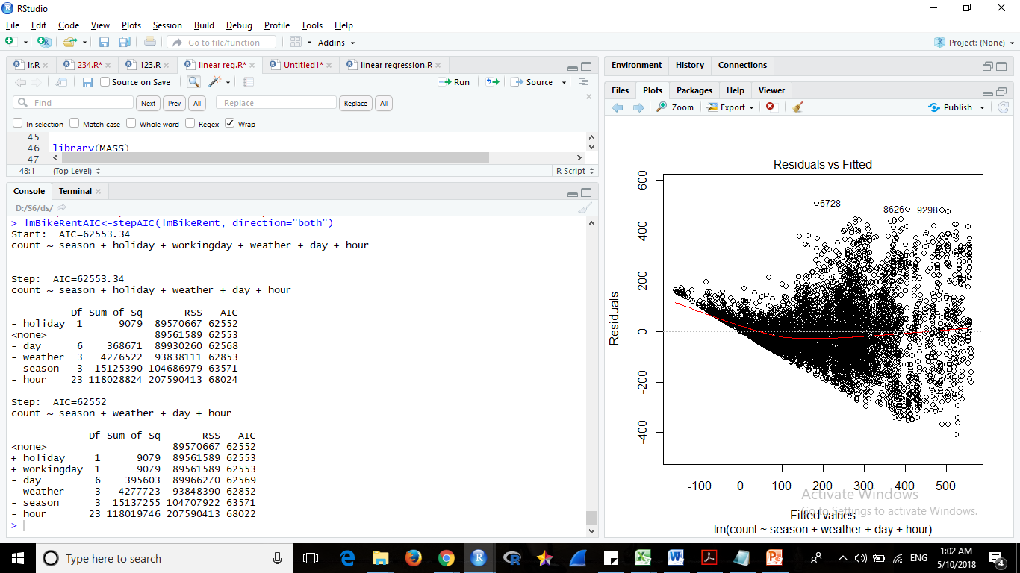
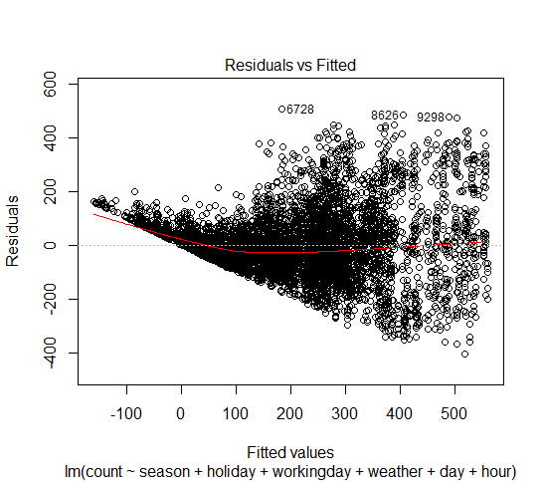
LINEAR REGRESSION
Linear Regression model was implemented on the training the dataset
Stepwise model selection was performed with AIC in both directions
Plotted the model

Slide 8
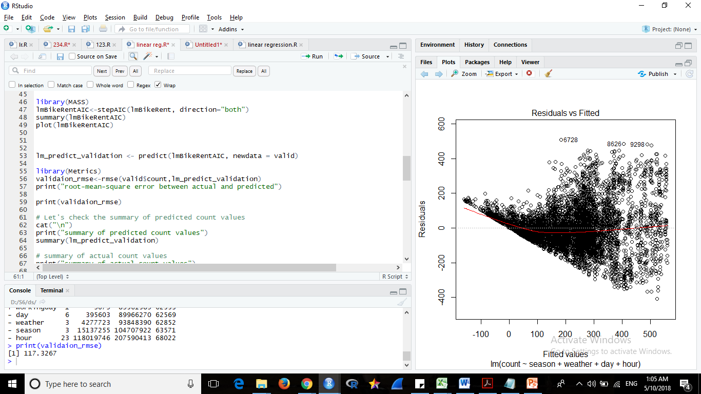
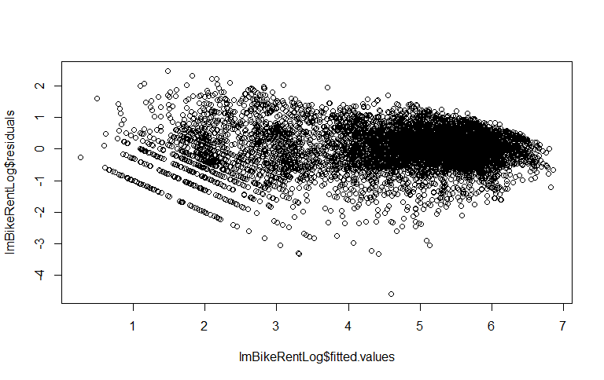
Count of the rented bikes was predicted using the model on the validation dataset and rmse value was calculated.
Residual vs fitted plot

Slide 9
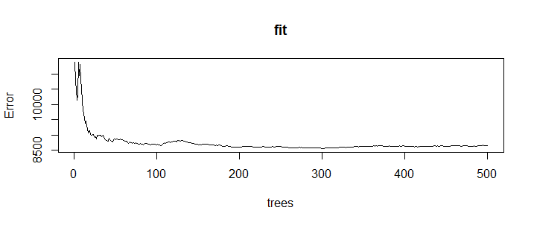
RANDOM FOREST
Random forest model was implemented on the training the dataset.
The model was plotted and as the number of trees increases the error decreases.
Count of the rented bikes was predicted using the model on the valid dataset and test dataset.
The rmse values are calculated.

Slide 10
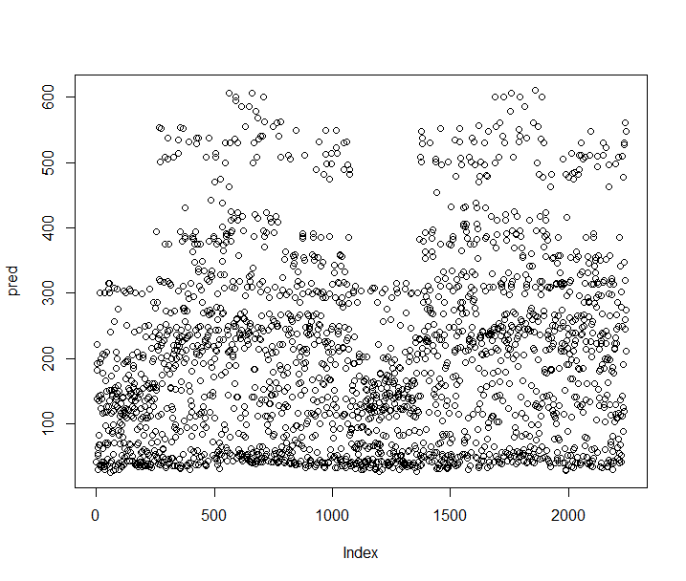
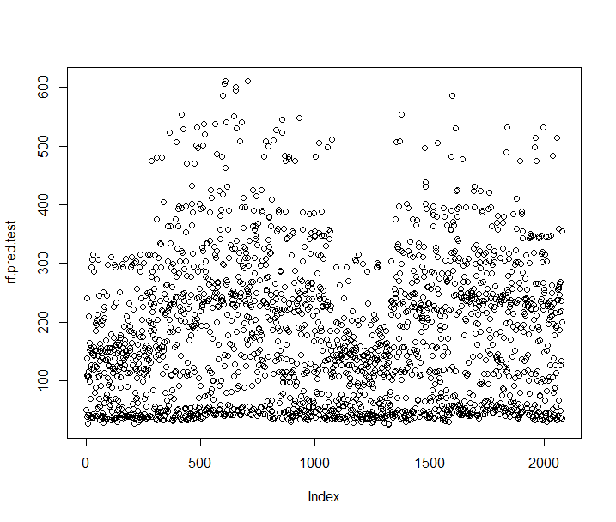
Predicted values of valid data set
Predicted values of test data

Slide 11
CONCLUSION
Linear regression and random forest methods were applied to the given dataset.
The root mean square error of valid dataset was calculated to the models and the rmse value of linear regression model was found to be more than random forest.
linear regression rmse : 117.3267
random forest rmse : 92.04388
So random forest was applied on the test dataset.
The count of the rented bikes was more accurate when predicted using random forest.

Slide 12
THANK YOU
Apurva Mandalika
Sindhu Krovvidi
RSD Pragnavi

